Slide 1
Out of the Box and Onto the Screen
Using Screencasts Outside the Classroom
Megan Berketis
EKU Writing Project Summer 2015

Slide 2
Conventional Peer Reviews
“Writers grow with regular response to their work and the work of other writers. Students need time to respond to each other about ideas”
Penny Kittle, Write Beside Them
Take a few minutes to jot down why you feel Peer Reviews are good.
  Why are they used? What are the good attributes of Peer Reviews? Are there any “Best Practices” in Peer Review Activities?

Slide 3
Digital Peer Reviews
“When students use a well-defined protocol to confer with one another, they build classroom community that moves beyond the simple ‘Hey, it’s good’ type of response, and they begin to understand the ways that other writers work, thereby adding to the strategies that they might be able to use on their own.”
Troy Hicks, The Digital Writing Workshop
www.screencast-o-matic.com/download

Slide 4
Try it Out!
Take about 10 minutes to open the writing sample and review the Author’s Agenda
  Take notes while you read the first time
  Highlight points of strength in the writing
  Formulate a few “On the edge questions” (See Protocol: “What if you…” “Why” “How” “Could this be…”)

Slide 5
Tips for a Successful Screencast
Pay attention to your physical presence: Speak Clearly, Smile, Don’t speak too fast
Start out with a positive statement. If you start out with your questions or suggestions the writer may dismiss your input
Don’t worry about how you look or sound. The screencast is not going to go viral or be on the Nightly News-it will go no further than your writing group who already knows what you look/sound like in person

Slide 6
Google Drive
After you complete your screencast using Screencast-o-matic you have two options: Upload to youtube or save onto your computer.
The latter is definitely the easier option if you want to put the screencast on google drive-and it’s pretty self-explanatory.
I’ve made a Minilesson screencast explaining how to upload a youtube video to Google Drive:

Slide 7
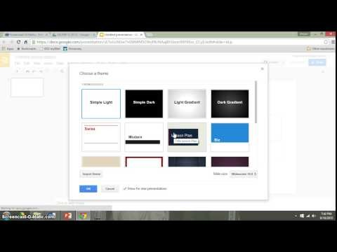
Quick Screencast Minilesson

Slide 8
Exit Slip
In your Writing Folder there is an Exit Slip Handout (Explo Screencast Exit Slip).
Please take a few moments to complete the questions.

Slide 9
Explo
What is different about this type of peer conferencing? Is it beneficial?
What can be done for student with no at-home internet access?
How much class time should still be given to peer writing talks?

